Slide 1
Computer Networks _22CS008
Noiseless Channels
Lecture (48-50)
Prepared By
Dr. Kiran Deep Singh
Department of Computer Science and Engineering,
Chitkara University, Punjab

Slide 2
Outline
Types of Protocols
Stop-and-wait protocol
Design of Stop-and-wait protocol
Flow Diagram of Stop-and-wait protocol

Slide 3
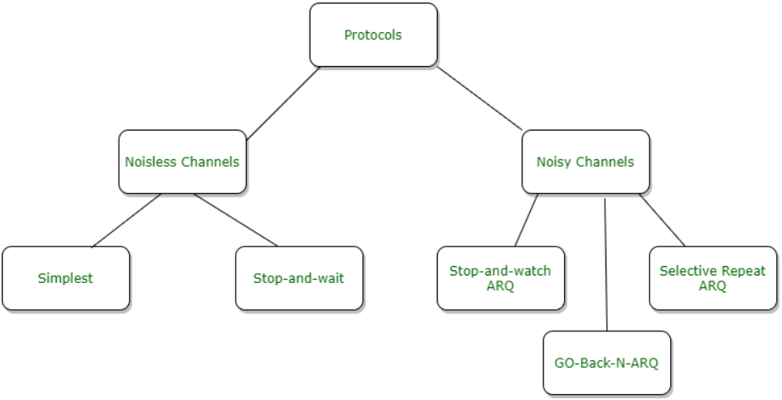
Types of Protocols
Figure 1: Types of Protocols.

Slide 4
Types of Protocols..
A noiseless channel is a theoretical communication channel where there's no data corruption, loss, or duplication. It's an ideal scenario that helps us understand basic data link protocols without the complexities of error handling.
Noiseless Channel
Simple Protocol
Stop and Wait Protocol

Slide 5
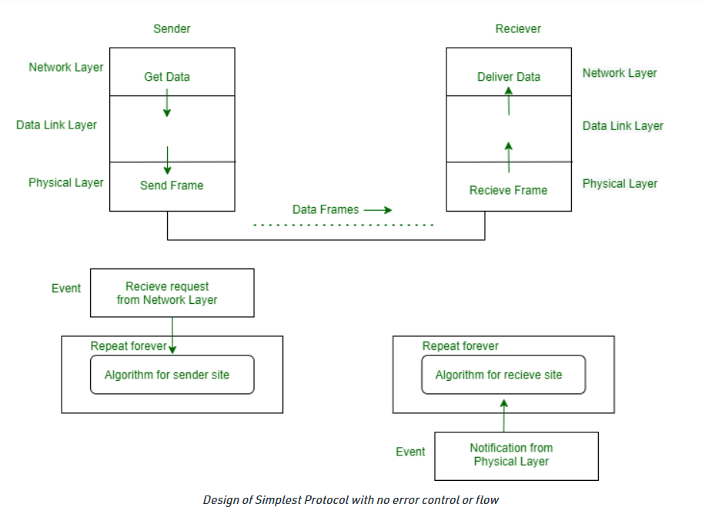
Simplest Protocol
An idealistic channel in which no frames are lost, corrupted or duplicated. The protocol does not implement error control in this category.
Figure 2: Design of Simplest Protocol with no error control and flow

Slide 6
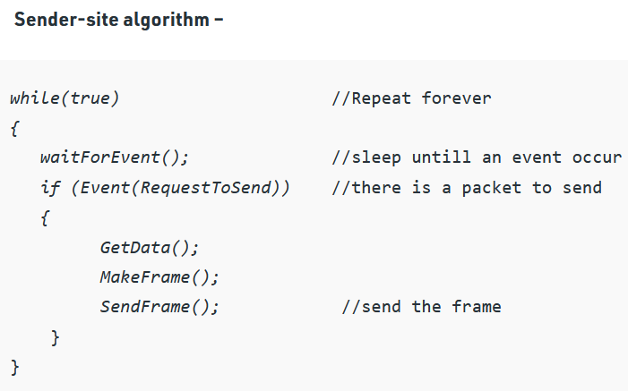
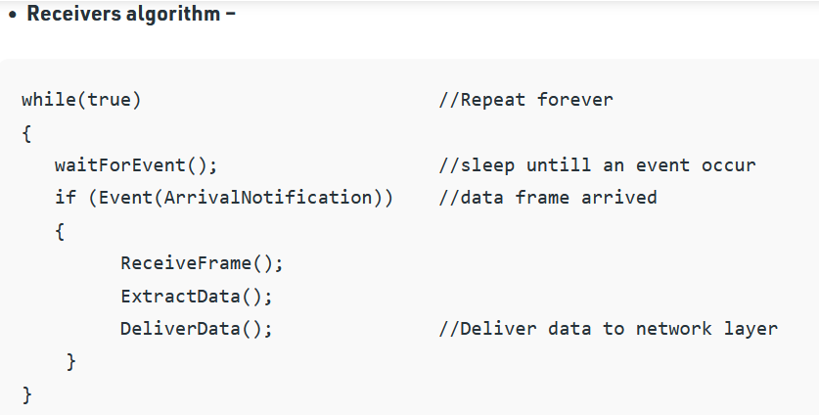
Algorithm for Simplest Protocol

Slide 7
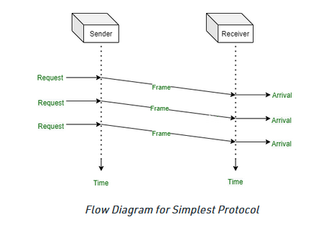
Flow for Simplest Protocol
Figure 3: Flow Diagram or Simplest Protocol

Slide 8
Stop-and-Wait Protocol
The Stop-and-Wait protocol is a simple data link protocol suitable for noiseless channels. It includes
Transmission: The sender transmits a single data frame to the receiver.
Waiting: The sender then waits for an acknowledgment (ACK) frame from the receiver indicating successful reception.
Acknowledgement: Upon receiving the data frame correctly, the receiver sends back an ACK frame.
Next Transmission: Once the sender receives the ACK, it transmits the next data frame in the sequence.

Slide 9
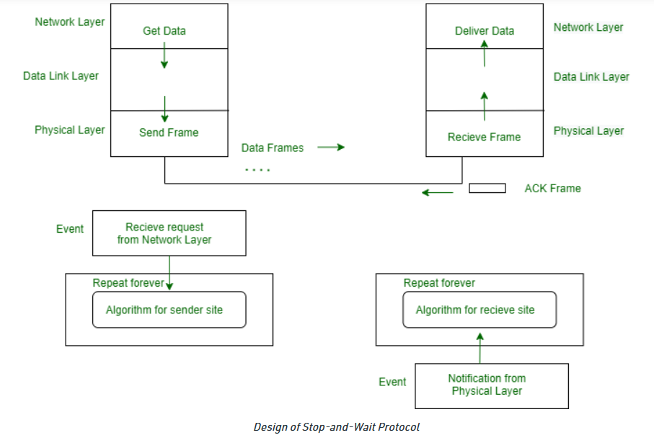
Design of Stop-and-Wait Protocol
Figure 4: Design of Stop n Wait Protocol

Slide 10
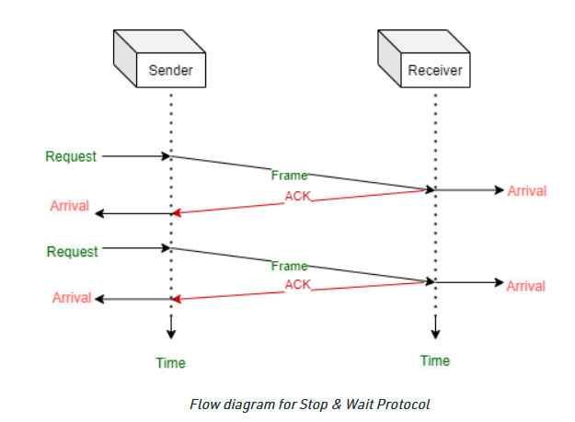
Flow Diagram
Figure 5: Flow Diagram for stop n Wait Protocol

Slide 11
Stop-and-Wait Protocol….
Key Points:-
Simple and Efficient: Stop-and-Wait is a straightforward protocol with low overhead, making it efficient for situations where reliability is not a major cn.
Flow Control: It inherently provides flow control by enoncersuring the sender doesn't overwhelm the receiver with data before it's processed.
Limited Throughput: A major drawback is the underutilization of the channel. The sender can only transmit the next frame after receiving the ACK, leading to idle time during waiting periods.
Benefits:-
Simplicity: It's easy to implement and understand, making it a good starting point for learning more complex protocols.
Limited Processing Power: In scenarios with limited processing power at either sender or receiver, Stop-and-Wait avoids overwhelming the system with continuous data flow.
Teaching Tool: Due to its simplicity, Stop-and-Wait serves as a valuable tool for teaching the fundamentals of data link protocols and flow control mechanisms.

Slide 12
Practice Questions
The Stop-and-Wait protocol is best suited for which type of communication channel?
High-bandwidth, real-time data transfer
Noiseless channel with limited processing power (Correct Answer)
Channel with frequent data loss and corruption
Network with unpredictable traffic patterns
In the Stop-and-Wait protocol, what happens after the sender transmits a data frame?
It continues transmitting the next frame immediately.
It waits for a timeout before retransmitting the same frame.
It waits for an acknowledgment (ACK) from the receiver. (Correct Answer)
It discards the frame and starts over.
What is a major drawback of the Stop-and-Wait protocol?
It requires complex error detection mechanisms.
It is unidirectional and cannot handle bi-directional communication.
It can lead to inefficient channel utilization due to waiting periods. (Correct Answer)
It is not suitable for simple data transfer tasks.

Slide 13
References
https://pinoybix.org/2017/07/mcq-in-network-layer-internet-protocol-forouzan.html
https://edurev.in/course/quiz/attempt/-1_Test-Ipv4--IP-Packet/0decdb37-7206-4824-afdd-d47013a5c4cd
https://www.geeksforgeeks.org/noiseless-channel-protocol/

